Slide 1


SAMRAT ASHOK TECHNOLOGICAL INSTITUTE,
VIDISHA (M.P.)
Minor Project Title :- Hellloo Doctor !!

Slide 2

Submitted By:-
Nilesh Deshmukh (0108CS191035)
Kapil Choukikar (0108CS191054)
Lokesh Dewda (0108CS191060)
Shivam Nagle (0108CS191110)
Mentor :-
Dr. Divya Rishi Sahu
(Project Guide)
Submitted To:-
Prof. Satish Pawar (Project Coordinator)
Prof. Mukesh Azad (Project Coordinator)
Dr. Kanak Saxena (Prof & Head of CSE)

Slide 3


ABOUT THE PROJECT
Hellloo Doctor !!
The name of the project is HELLLOO DOCTOR !! .
Where we design a website for the patient .
This Website provide a platform for the user to book his appointment at the moment of his favourite Doctor.
This document provides details about the entire Website requirements specification for the online platform .
The purpose of this project is to provide convenience to patients by easy way to take the appointment of Doctor by his/her choice.

Slide 4
The website provides the following facilities to the User :-
Provides Patient Authentication and Authorisation using JWT Token.
Added CRUD operation for Creation , Updation & Deletion.
Facilities for the patient to take an appointment with available Doctors.
Provides facility for future correspondence.
Doctors able to register for giving treatment to Patient.
Build Dashboard for showing the Number of Patient and Doctor.

Slide 5
Problem Statement & Benefit of Online Appointment
& Other Facilities.
The main reason behind developing this project is the problems which were faced by the patient when user come to Hospital and get appointment late then he think.
Convenience:- Unlike Hospital has very much crowd so we provide user very quick appointment and they're only a mouse click away.
Accessibility:- If you're out of Town or even out of the State when a money problem arises, you can log on instantly to online bank and take care of business, 24/7.

Slide 6
Efficiency:- You can access and manage all your hospital details from secure site.
Transaction:- Online Hospitals sites generally execute and confirm transactions at or quicker than ATM processing speeds.
How Online Hospital Site works?
Websites uses for patient to book an Appointment with
Doctors , Provides Doctor to meet up with Patients,
shows Appointment , Gives a list of all the patient .
Gives a payslip to the User
Added verification for the Users

Slide 7
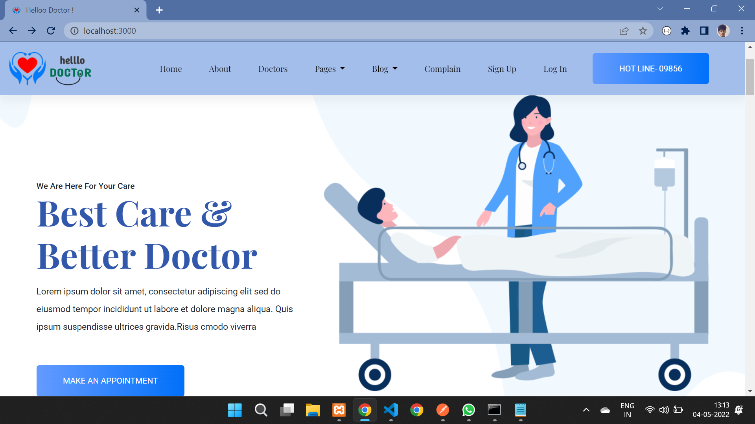
WEBSITE
Desktop Site

Slide 8
Functional Requirements
This site requires the facility for a non account holder to apply for opening an account to corresponding sites.
Enable an account holder of the Hospital sites to registered to use the application.
Requires valid and accurate information of clients so checks for the authenticity of user at client end.
Store and Retrieve data from the database .
Searches and Display all relevant information related to User & their information.
User can get the mails related to the current schemes and their medical state.
User can take news of Doctor Location aspects.
User can available discounts on their appointment by applying coupons.

Slide 9
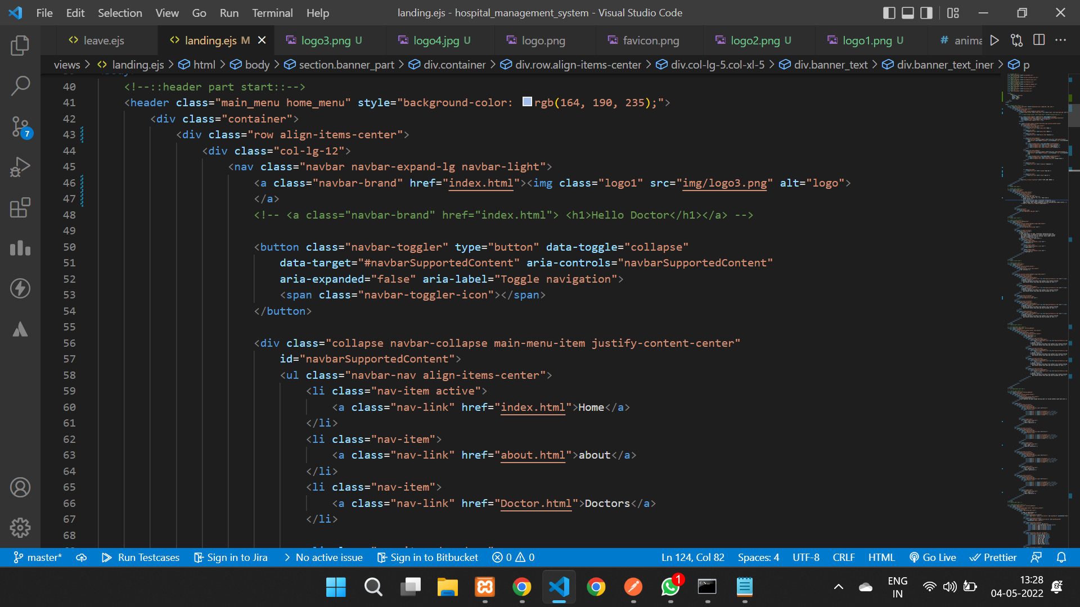
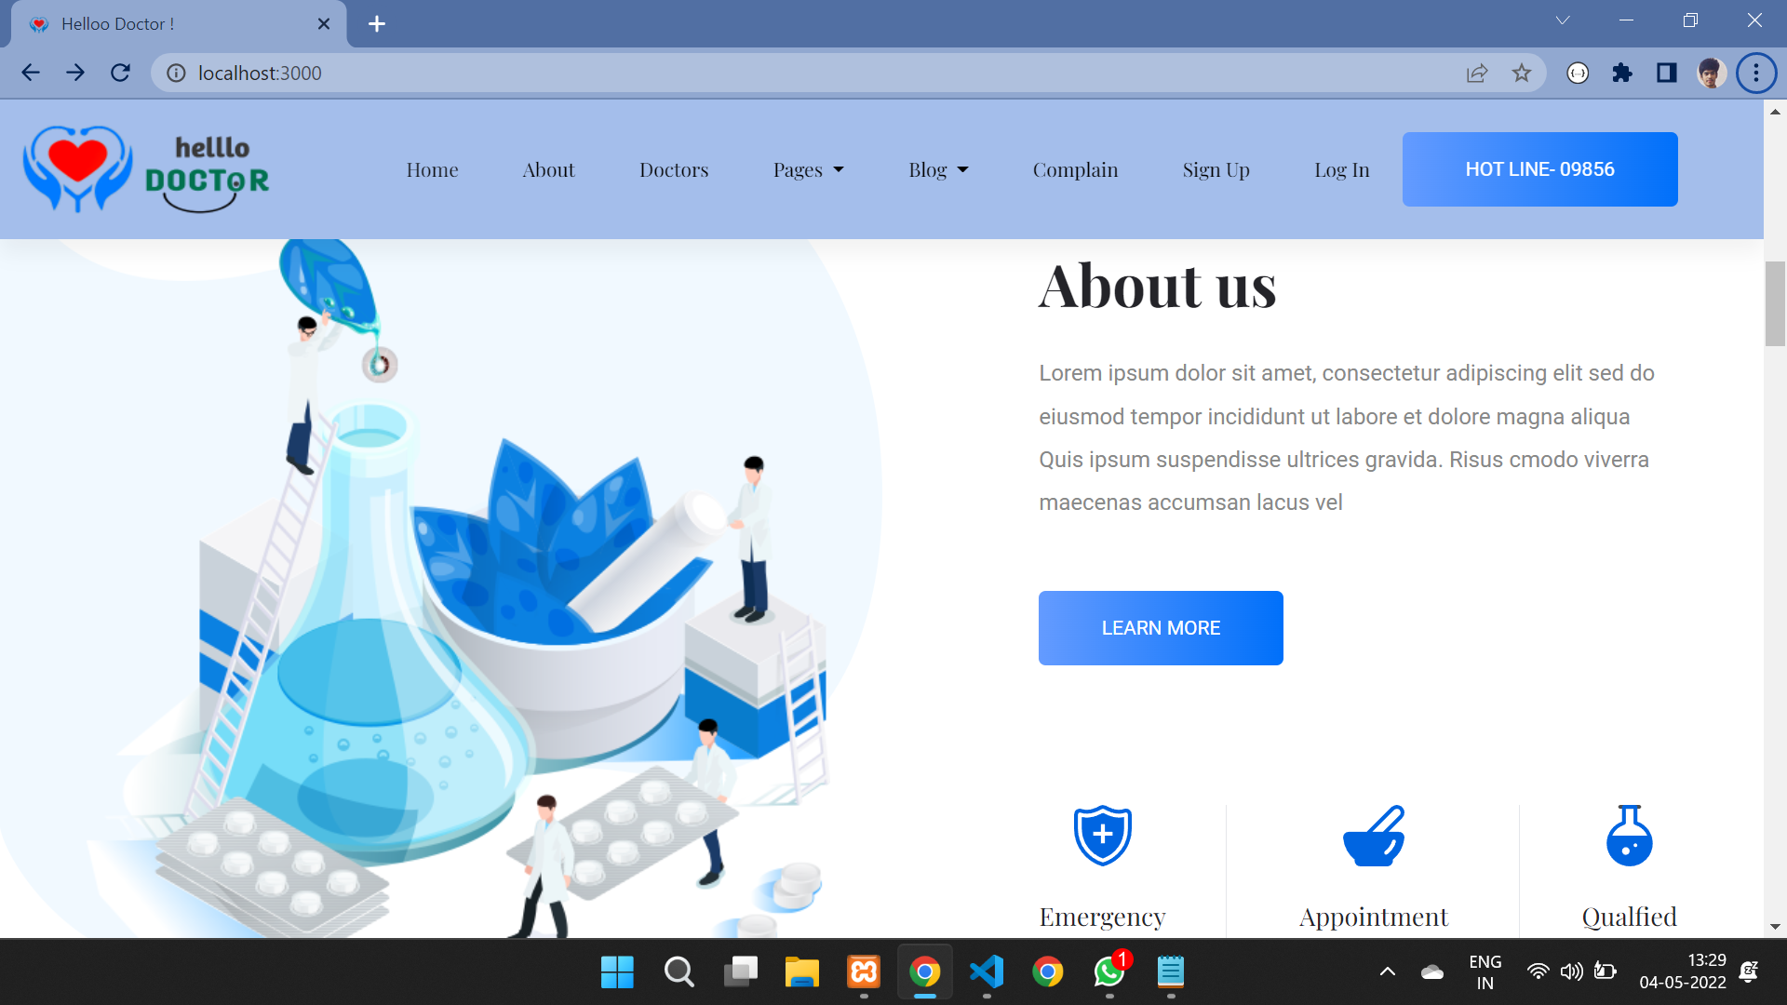
WEBSITE CODE
HOME PAGE

Slide 10
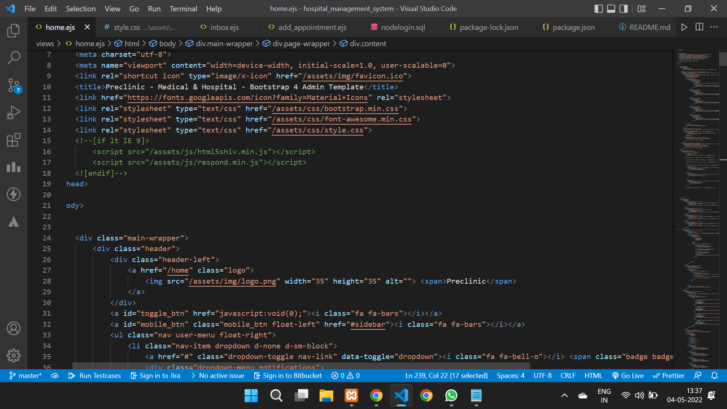
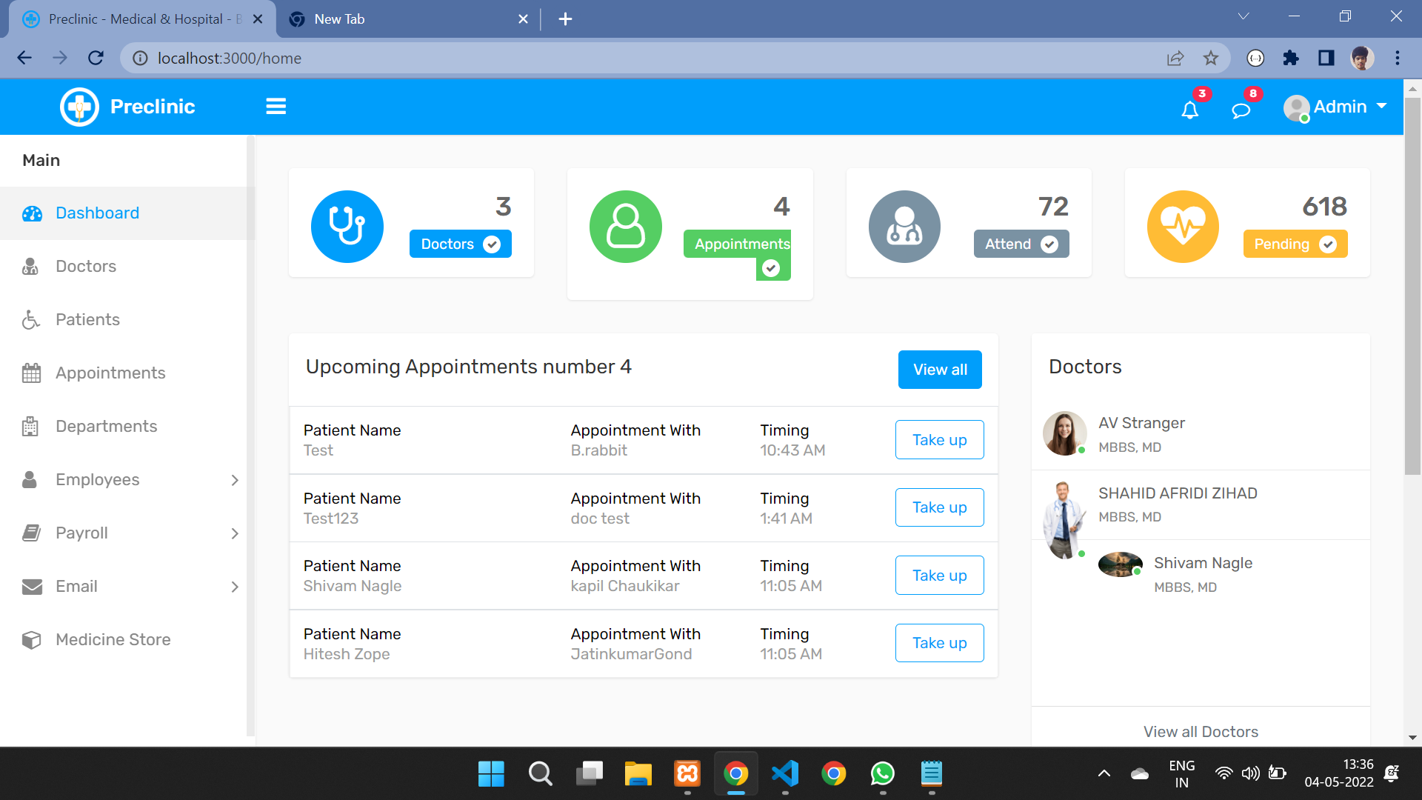
DASHBOARD

Slide 11
HEADER
TEXT
ICONS
SLIDER
TOOLS / ENVIRONMENT USING
FRONT END
HTML
Hypertext Markup Language, or HTML, is a programming language used to describe the structure of information
on a webpage.
HTML is the skeleton of all web pages and its most basic building block.
CSS
CSS stands for Cascading Style Sheets. It is the coding language that gives a website its look and layout.
Along with HTML, CSS is fundamental to web design. Without it, websites would still be plain text on white
backgrounds.
JAVASCRIPT
JavaScript is a programming language that adds interactivity
to your website. This happens in games, in the behavior of
responses when buttons are pressed or with data entry on
forms; with dynamic styling; with animation, etc.

Slide 12
EXPRESS.JS
Express.js is a web application framework for Node.js. It provides various features that make web
application
development fast and easy which otherwise takes more time using only Node.js.
Express.js is based on the Node.js middleware module called connect which in turn uses http module.
So, any middleware which is based on connect will also work with Express.js.
GitHub
GitHub is an increasingly popular programming resource used for code sharing. It's a social
networking site for programmers that many companies and organizations use to facilitate project
management and collaboration.

Slide 13
BACK END
NODE JS
Node.js (Node) is an open source development platform for executing JavaScript code server-side. Node is
useful for developing applications that require a persistent connection from the browser to the server and is
often used for real-time applications such as chat, news feeds and web push notifications.
DATABASE (MySQL)
MySQL is a relational database management system (RDBMS) developed by Oracle that is based on
structured query language (SQL).
A database is a structured collection of data. It may be anything from a simple shopping list to a picture
gallery or a place to hold the vast amounts of information in a corporate network. In particular, a relational
database is a digital store collecting data and organizing it according to the relational model.

Slide 14



THANKS!
Nilesh Deshmukh
Kapil Choukikar
Shivam Nagle
Lokesh Dewda
Does anyone have any question?
kapil19cs054@satiengg.in
+91 9926822836

